Slide 1

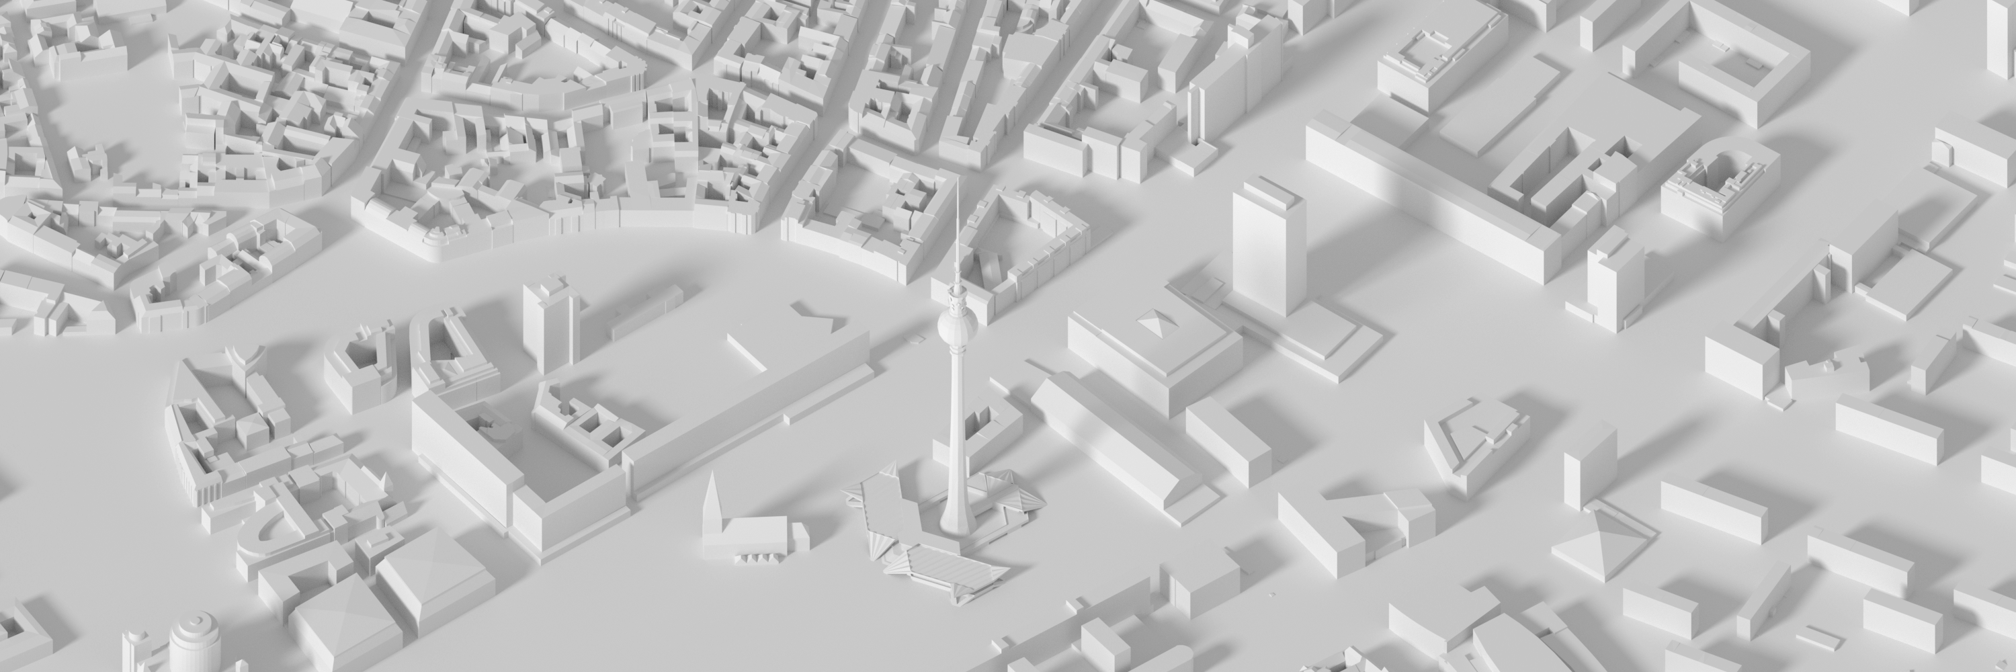
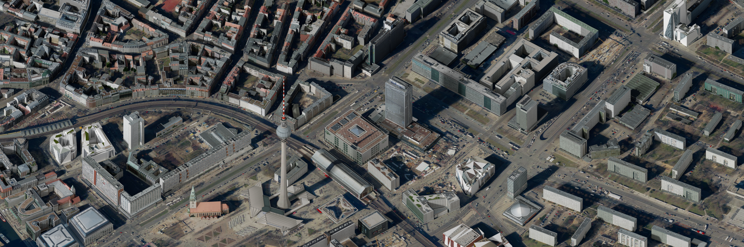
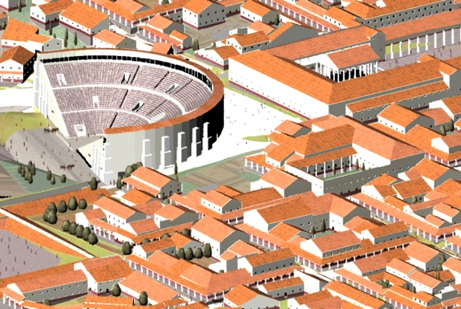
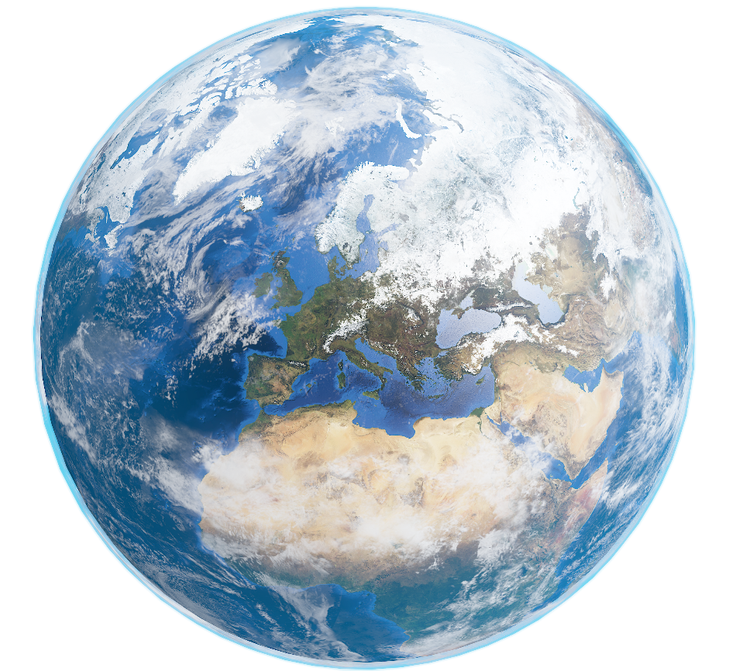



Processing Geodata using Python and Open Source Modules
Prof. Martin Christen FHNW – University of Applied Sciences and Arts Northwestern Switzerland School of Architecture, Civil Engineering and Geomatics Institute Geomatics
martin.christen@fhnw.ch
MartinChristen GitHub: MartinChristen
GitLab: martin.christen

Slide 2
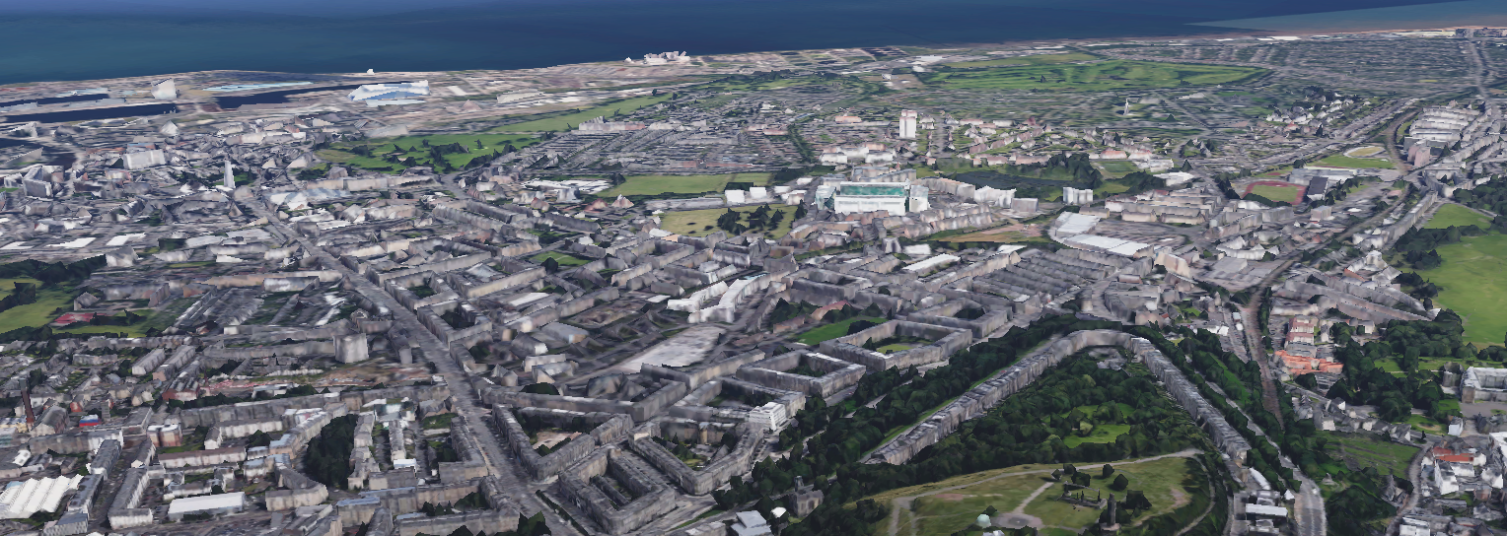
Processing Geodata using Python and Open Source Modules
Geodata ? Geographic data and information are defined in the ISO/TC 211 series of standards as data and information having an implicit or explicit association with a location relative to the Earth.
Approximately 90% of government sourced data has a location component. https://www.iso.org/committee/54904.html
GIS – Geographic Information System GIS is a system designed to capture, store, manipulate, analyze, manage, and present spatial or geographic data. Popular GIS are for example ArcGIS (ESRI) and QGIS – both can be extended by using Python. Python ? This talk will show you the basics of manipulating, analyzing and presenting geodata using Python (in the Jupyter Notebook.)

Slide 3
Important Open Source Libraries / Modules
GDAL/OGR
GEOS
Geospatial Data Abstraction Library
C/C++ with Python Bindings
Reading Vector & Raster Formats
Geometry Engine Open Source C++
Geometry processing / OpenGIS Simple Features
Rasterio
For raster data
Pythonic Module
fiona
For vector data
Pythonic Module
shapely
For vector data
Pythonic Module
geopandas
Pythonic Module
Notes:
Numpy, matplotlib

Slide 4
Jupyter Notebook / Sample Data for this talk
https://github.com/martinchristen/EP2018_Geo

Slide 5
Installation
https://github.com/martinchristen/EP2018_Geo
conda install shapely
conda install fiona
conda install rasterio
conda install geopandas
conda install folium -c conda-forge
Python 3.6 required (3.7 doesn’t support all Modules yet)

Slide 6
https://github.com/martinchristen/EP2018_Geo

Slide 7
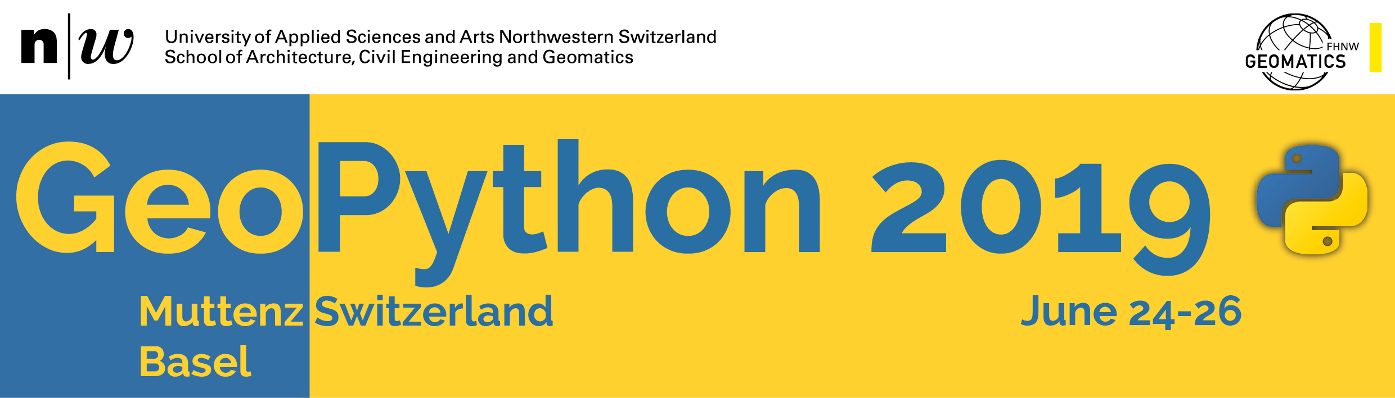
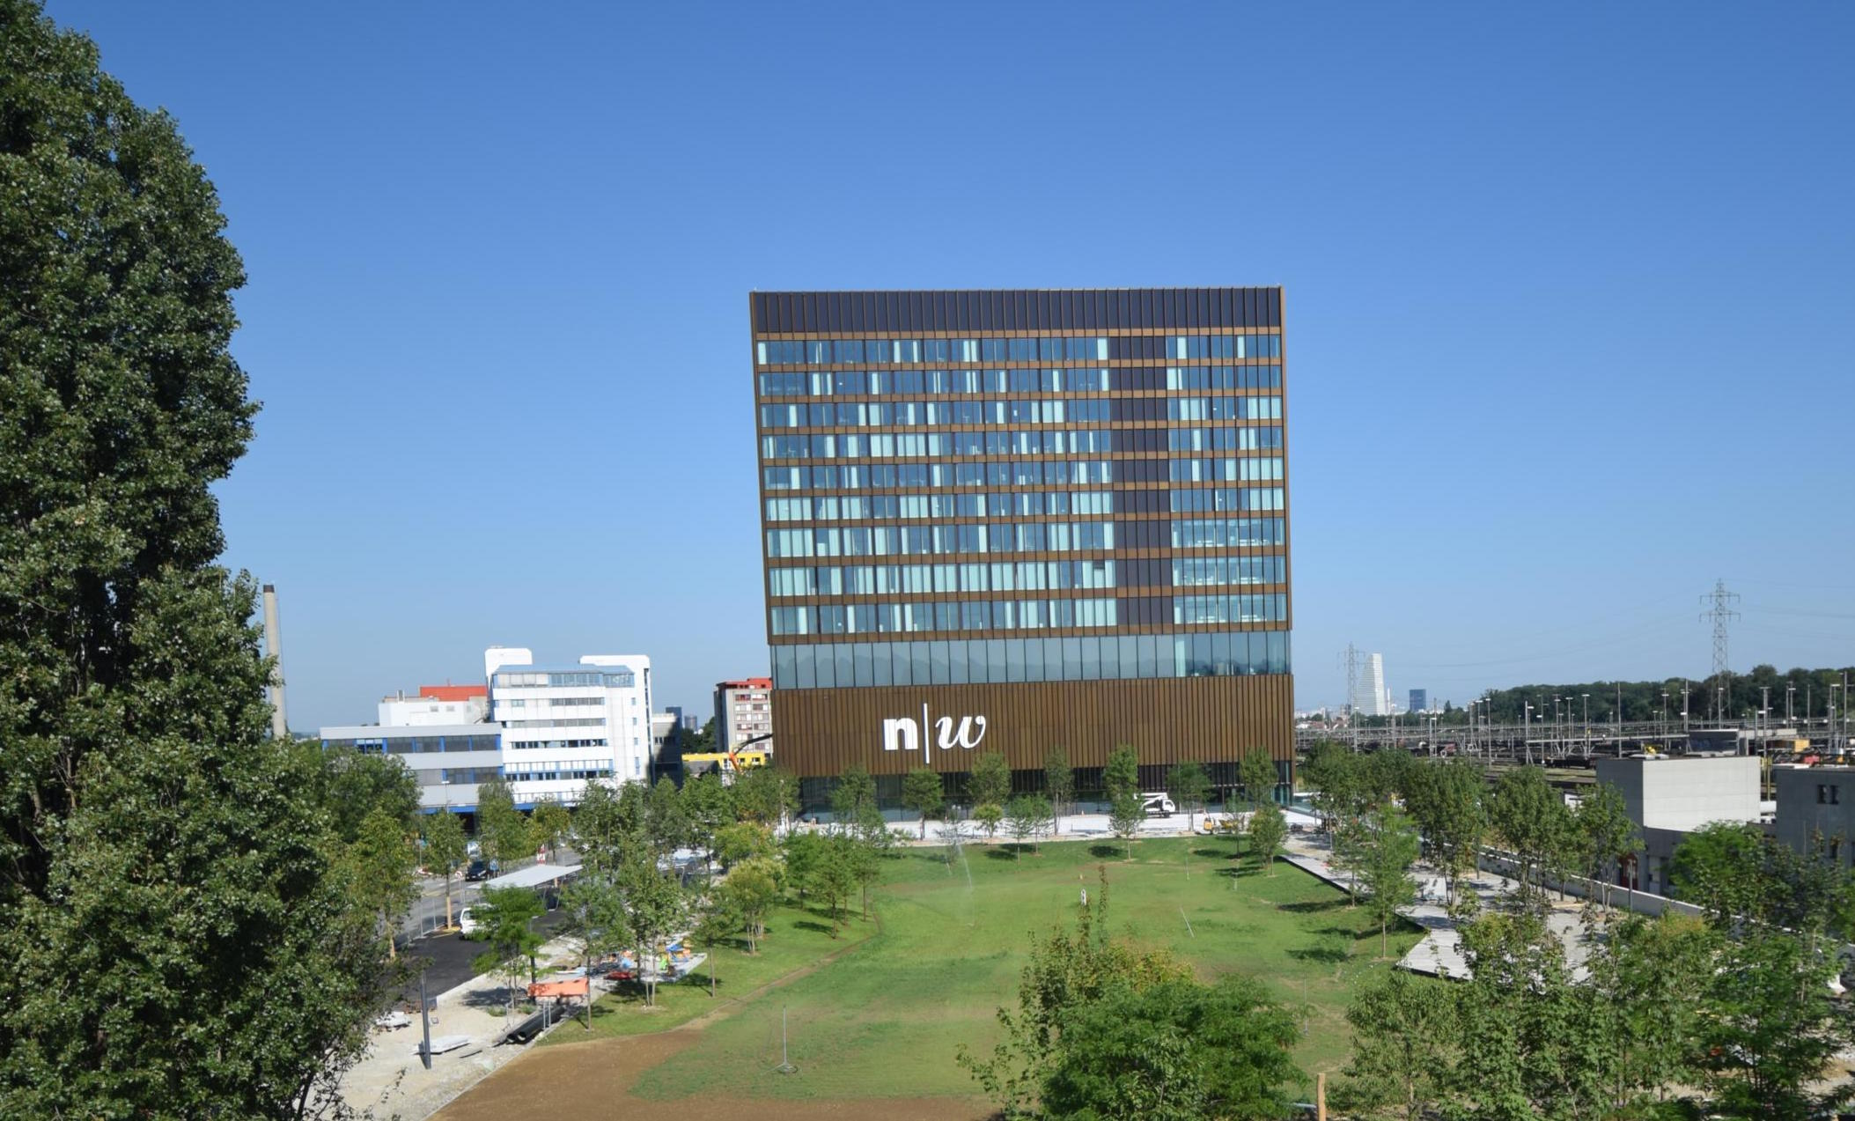
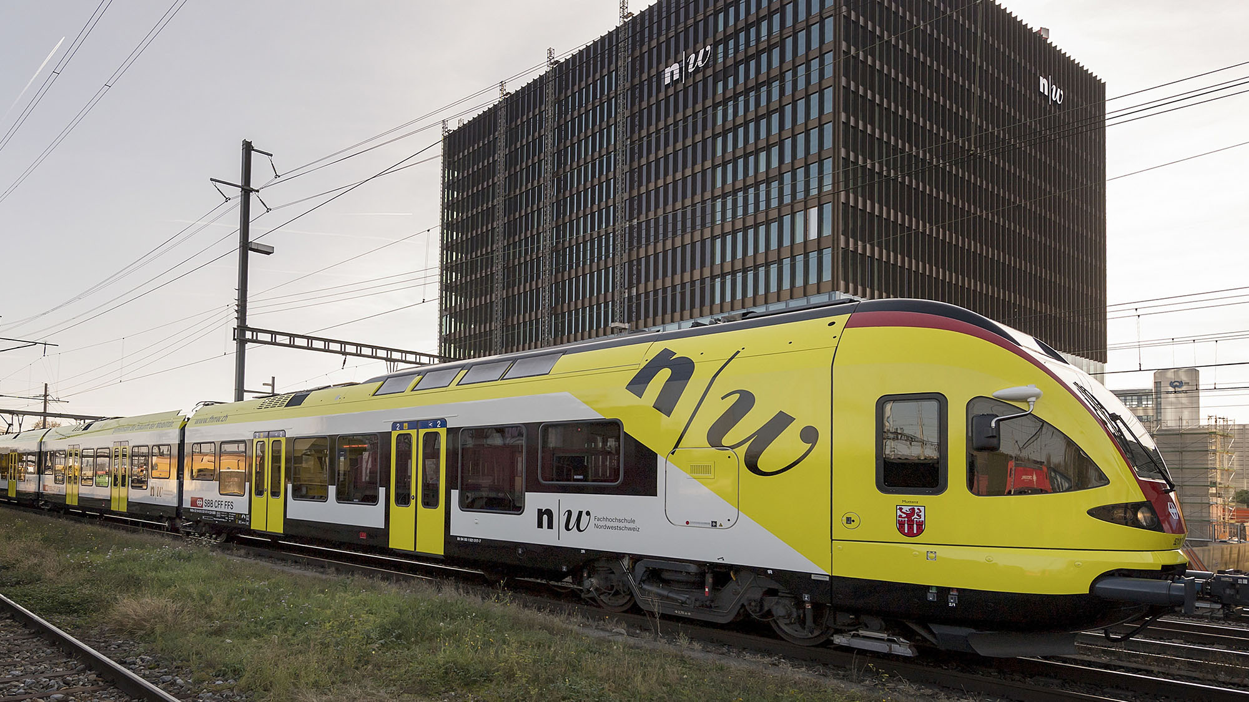
http://2019.geopython.net
Python in General
GIS/Mapping
Geography / Geophysics / Geodesy / Geomatics
Earth Sciences / Environmental Sciences
Geovisualization
Smart Cities
Spatial Data / Geodata
Geospatial Webservices
Big Data
Data Processing
(Spatial) Databases
Computer Vision
Remote Sensing
Image Processing
Machine Learning / Deep Learning

Slide 8
Questions
?

